Slide 1
Foundations of Cryptography one-time pad and its limitations
LiangFeng Zhang
zhanglf@shanghaitech.edu.cn

Slide 2
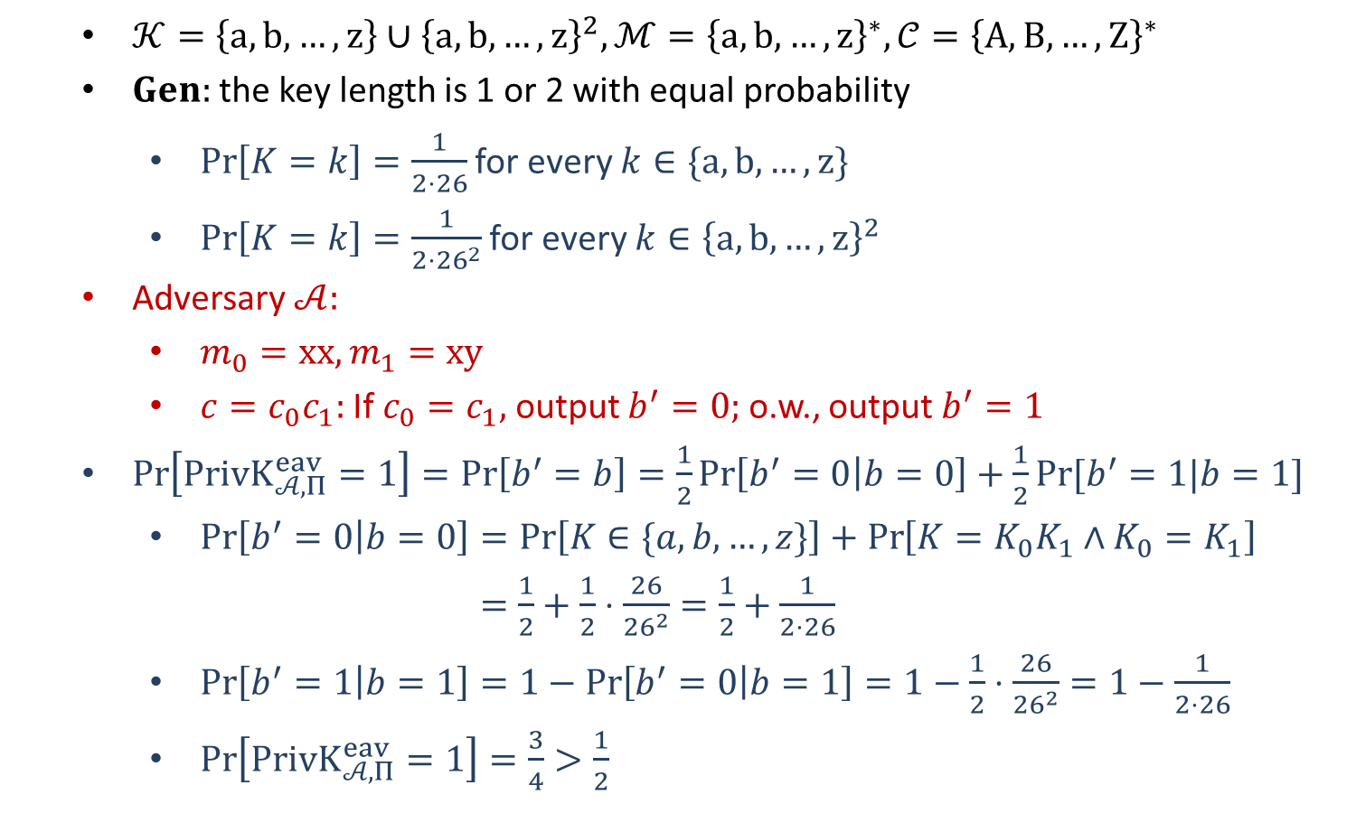
Example: Vigenère Cipher
$𝒦=\left\{a,b,…,z\right\}∪{\left\{a,b,…,z\right\}}^{2}, ℳ={\left\{a,b,…,z\right\}}^{∗}, 𝒞={\left\{A,B,…,Z\right\}}^{∗}$
$Gen:$the key length is 1 or 2 with equal probability
$\operatorname{Pr}\left[K=k\right]=\frac{1}{2⋅26}$ for every $k∈\{a,b,…,z\}$
$\operatorname{Pr}\left[K=k\right]=\frac{1}{2⋅{26}^{2}}$ for every $k∈{\left\{a,b,…,z\right\}}^{2}$
Adversary $𝒜:$
$m_{0}=xx, m_{1}=xy$
$c=c_{0}c_{1}:$ If $c_{0}=c_{1},$ output $b^{′}=0;$o.w., output $b^{′}=1$
$\operatorname{Pr}\left[PrivK_{𝒜, Π}^{eav}=1\right]=\operatorname{Pr}\left[b^{′}=b\right]=\frac{1}{2}\operatorname{Pr}\left[b^{′}=0 | b=0\right]+\frac{1}{2}Pr⁡[b^{′}=1|b=1]$
$\operatorname{Pr}\left[b^{′}=0 | b=0\right]=\operatorname{Pr}\left[K∈\{a,b,…,z\}\right]+\operatorname{Pr}\left[K=K_{0}K_{1}∧K_{0}=K_{1}\right]$
$=\frac{1}{2}+\frac{1}{2}⋅\frac{26}{{26}^{2}}=\frac{1}{2}+\frac{1}{2⋅26}$
$\operatorname{Pr}\left[b^{′}=1 | b=1\right]=1−\operatorname{Pr}\left[b^{′}=0 | b=1\right]=1−\frac{1}{2}⋅\frac{26}{{26}^{2}}=1−\frac{1}{2⋅26}$
$\operatorname{Pr}\left[PrivK_{𝒜, Π}^{eav}=1\right]=\frac{3}{4}>\frac{1}{2}$
not perfectly indistinguishable!

Slide 4
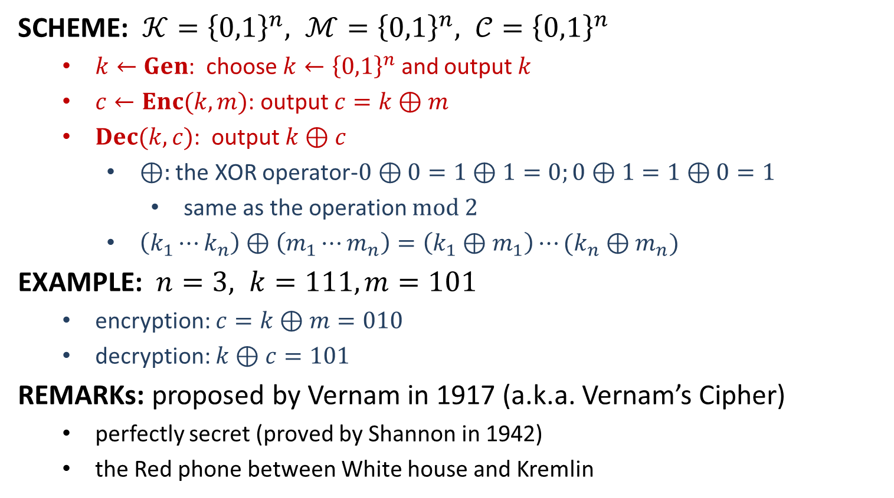
One-Time Pad
SCHEME: $𝒦={\left\{0,1\right\}}^{n}, ℳ={\left\{0,1\right\}}^{n}, 𝒞={\left\{0,1\right\}}^{n}$
$k←Gen$: choose $k←{\left\{0,1\right\}}^{n}$ and output $k$
$c←Enc(k,m)$: output $c=k⊕m$
$Dec(k,c)$: output $k⊕c$
$⊕:$ the XOR operator-$0⊕0=1⊕1=0;0⊕1=1⊕0=1$
same as the operation $mod 2$
$\left(k_{1}⋯k_{n}\right)⊕\left(m_{1}⋯m_{n}\right)=\left(k_{1}⊕m_{1}\right)⋯(k_{n}⊕m_{n})$
EXAMPLE: $n=3, k=111, m=101$
encryption: $c=k⊕m=010$
decryption: $k⊕c=101$
REMARKs: proposed by Vernam in 1917 (a.k.a. Vernam’s Cipher)
perfectly secret (proved by Shannon in 1942)
the Red phone between White house and Kremlin

Slide 5
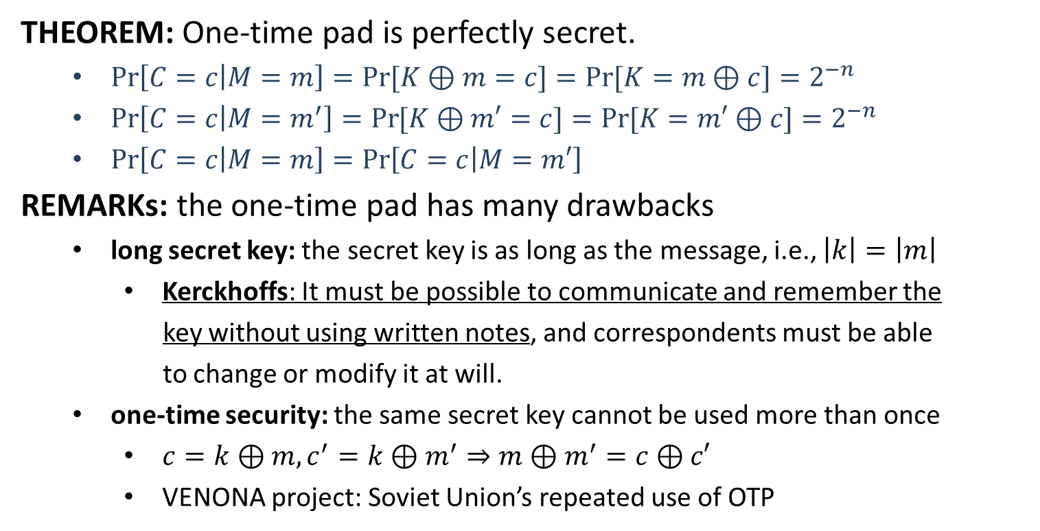
One-Time Pad
THEOREM: One-time pad is perfectly secret.
$\operatorname{Pr}\left[C=c | M=m\right]=\operatorname{Pr}{[K⊕m=c]}=Pr⁡[K=m⊕c]=2^{−n}$
$\operatorname{Pr}\left[C=c | M=m^{′}\right]=\operatorname{Pr}{[K⊕m′=c]}=Pr⁡[K=m′⊕c]=2^{−n}$
$\operatorname{Pr}\left[C=c | M=m\right]=\operatorname{Pr}\left[C=c | M=m′\right]$
REMARKs: the one-time pad has many drawbacks
long secret key: the secret key is as long as the message, i.e., $\left|k\right|=\left|m\right|$
Kerckhoffs: It must be possible to communicate and remember the
key without using written notes, and correspondents must be able
to change or modify it at will.
one-time security: the same secret key cannot be used more than once
$c=k⊕m, c^{′}=k⊕m^{′}⇒m⊕m^{′}=c⊕c′$
VENONA project: Soviet Union’s repeated use of OTP

Slide 6
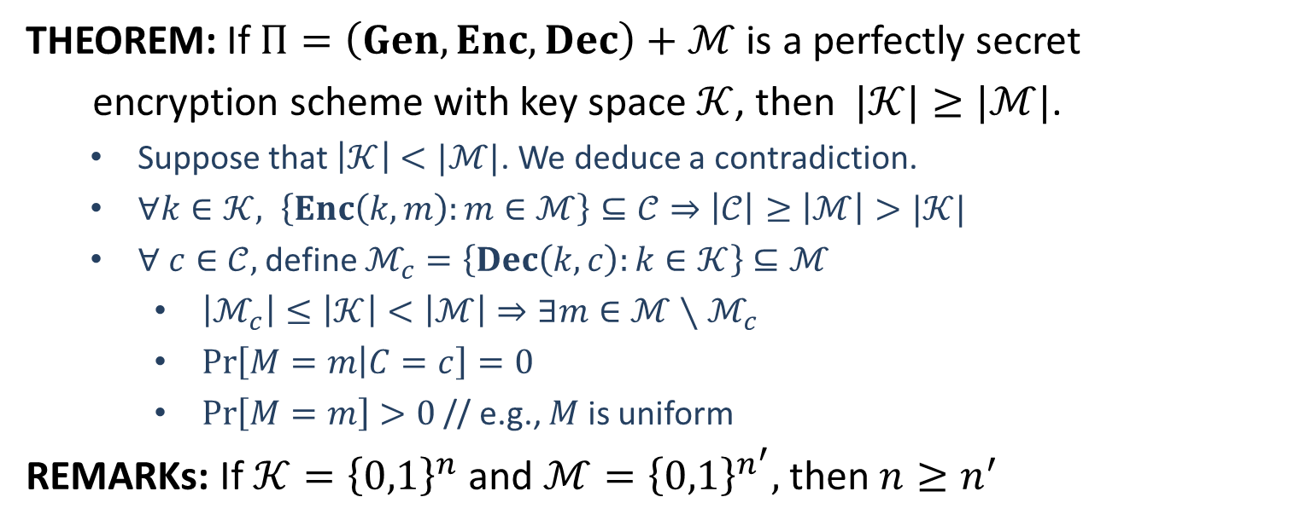
Limitations
THEOREM: If $Π=\left(Gen, Enc, Dec\right)+ℳ$ is a perfectly secret
encryption scheme with key space $𝒦$, then $|𝒦|≥|ℳ|$.
Suppose that $\left|𝒦\right|<|ℳ|$. We deduce a contradiction.
$∀k∈𝒦, \left\{Enc\left(k,m\right):m∈ℳ\right\}⊆𝒞⇒\left|𝒞\right|≥\left|ℳ\right|>|𝒦|$
$∀ c∈𝒞,$ define $ℳ_{c}=\left\{Dec\left(k,c\right):k∈𝒦\right\}⊆ℳ$
$\left|ℳ_{c}\right|≤\left|𝒦\right|<\left|ℳ\right|⇒∃m∈ℳ∖ℳ_{c}$
$\operatorname{Pr}\left[M=m | C=c\right]=0$
$\operatorname{Pr}\left[M=m\right]>0$ // e.g., $M$ is uniform
REMARKs: If $𝒦={\left\{0,1\right\}}^{n}$ and $ℳ={\left\{0,1\right\}}^{n^{′}},$then $n≥n^{′}$

